Slide 1
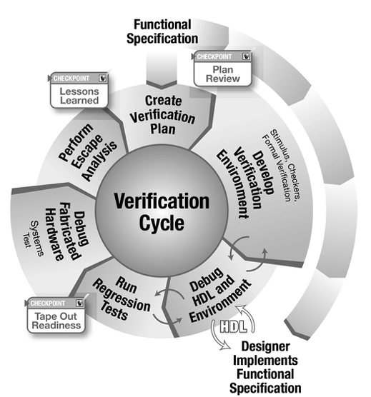


ECE 593
Fundamentals of Pre-Silicon Validation
Venkatesh Patil
Electrical and Computer Engineering Department
Maseeh College of Engineering and Computer Science

Slide 2
IMPLEMENTATION AND VERIFICATION OF ASYNCHRONOUS FIFO USING BOTH CLASS-BASED AND UVM METHODOLOGIES
S2 – G10
Manoj Bontalakoti manojmur@pdx.edu
Balasainath Reddy Yelampalle bala@pdx.edu
Nikhilesh Devarasetty nikhi@pdx.edu
Tanvitha Koganti koganti@pdx.edu
Date: 06/11/2024

Slide 3
Agenda
Introduction of Team Members
Project Introduction
Design Implementation
Class based Verification
UVM based Verification
Overall Challenges and Learnings
Demo
Q & A

Slide 4
Team Introductions
Team Member Name | Task Category
Manoj Bontalakoti | UVM Based Verification
Balasainath Reddy Yelampalle | UVM Based Verification
Nikhilesh Devarasetty | Class Based Verification
Tanvitha Koganti | Class Based Verification

Slide 5
Project Introduction
  An asynchronous FIFO buffer transfers data between two clock domains with different frequencies. This project designs and verifies a reliable asynchronous FIFO.
Write Frequency (fA): 500 MHz
Read Frequency (fB): 225 MHz
Burst Length: 1024 data items
Idle Cycles between Writes: 3
Idle Cycles between Reads: 2

Slide 6
Design Implementation
The asynchronous FIFO design is based on the well-established principles outlined in industry-standard texts and reference designs, ensuring robustness and reliability
Quick Specification:
Depth: Configurable up to 409 entries
Data Width: 32 bits
Clock Domains: Independent read and write clocks
Control Signals: Full, Empty, Read Enable, Write Enable
Features: Gray-coded pointers for addressing, dual-port RAM for storage, and synchronization registers to handle clock domain crossing

Slide 7
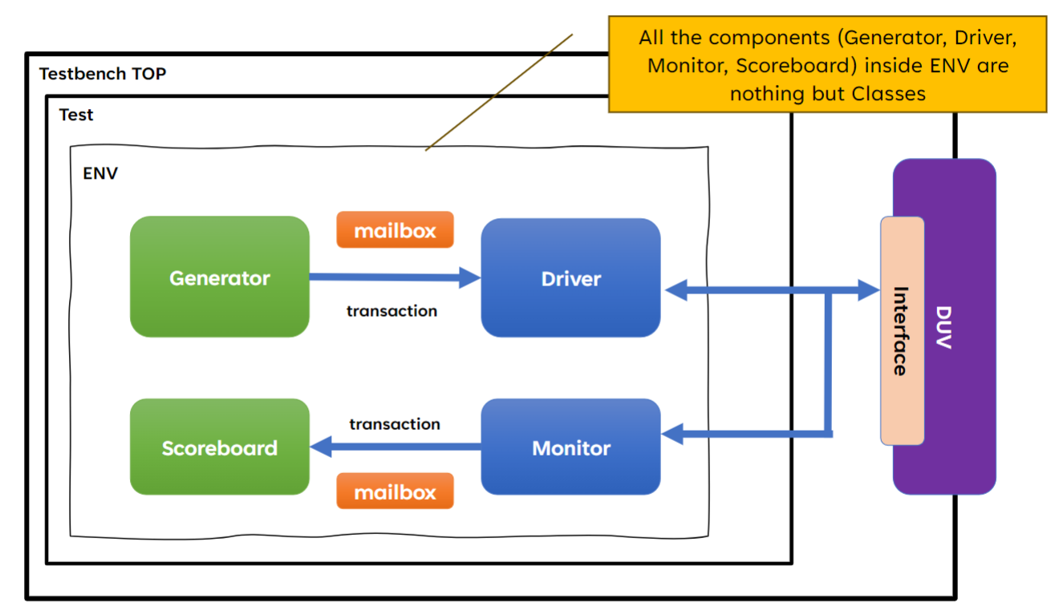
Class based Verification

Slide 8
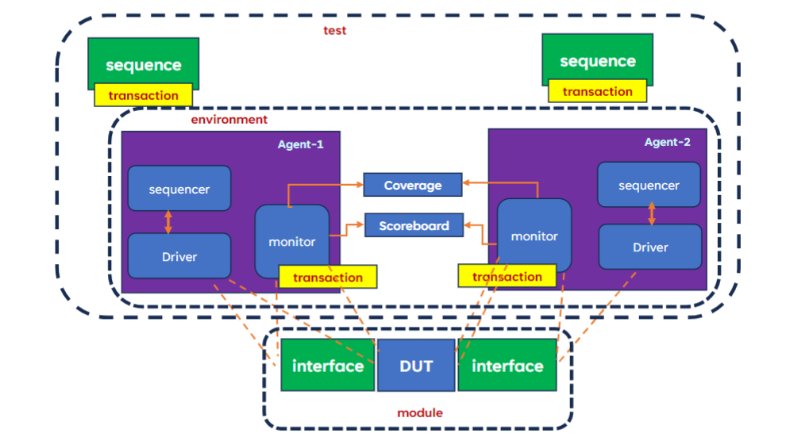
UVM based Verification

Slide 9
Test Scenarios
Basic Functionality: Verify basic write and read operations.
Boundary Conditions: Test FIFO at near-full and near-empty conditions.
Simultaneous Operations: Ensure write and read do not occur simultaneously.
Overflow and Underflow: Check behavior when FIFO is full or empty.
Metastability Handling: Validate synchronization logic between clock domains.
Error Handling: Test with deliberate errors to check detection mechanisms.
Reset Conditions: Verify FIFO reset functionality in various states.
Performance under Load: Stress test with maximum and burst data rates.

Slide 10
Coverage
Code Coverage :
Statement Coverage: Ensuring all executable statements are exercised.
Branch Coverage: Testing all conditional branches within the FIFO logic.
Path Coverage: Verifying all possible execution paths in the design code
Functional Coverage :
Full and Empty Conditions: Track FIFO reaching full and empty states.
Read and Write Operations: Count and validate all read/write operations.
Pointer Crossings: Monitor read/write pointer transitions across clock domains.
Error Events: Record occurrences of detected errors.
Reset Operations: Measure reset operation effectiveness under different conditions.

Slide 11
Conclusion
Our project successfully designed and verified a robust asynchronous FIFO with enhanced metastability handling and error-checking mechanisms. Comprehensive testing and coverage metrics ensured reliable performance and correctness across different clock domains.

